Slide 1

Chapter 7
Advanced Form Validation
and Model Forms

Slide 2

Objectives
You will learn how to set the initial values on your form and customize the widgets (the HTML input elements that are being generated).
Will learn about the differences between sending form data in a GET HTTP request and sending it in a POST HTTP request.
Will know how Django's form library is used to build and validate forms automatically.

Slide 3
Objectives
You will know how to add extra multi-field validation to Django forms.
How to customize and set form widgets for fields.
How to use ModelForms to automatically create a form from a Django model, and how to automatically create Model instances from ModelForms.

Slide 4
Custom Field Validation and Cleaning

Slide 5
Custom Validators
A validator is simply a function that accepts a value and raises django.core. exceptions.ValidationError if the value is invalid – the validity is determined by the code you write.

Slide 6
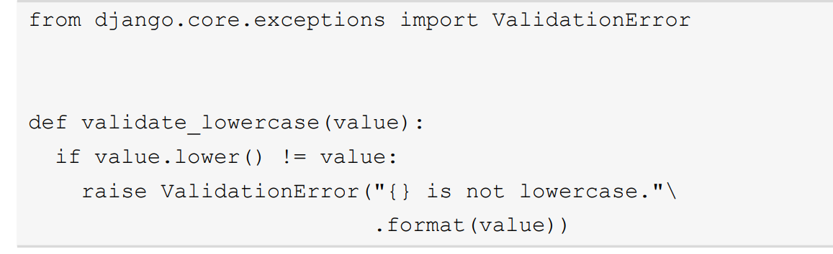
Custom Validators
Validates whether a value is lowercase
Notice the function does not return anything, for either success or failure. It will just raise ValidationError if the value is not valid.

Slide 7
Custom Validators
The validator can be passed to the validators argument of a field constructor on a form, inside a list; for example, to our text_input field from our ExampleForm:

Slide 8
Cleaning Methods
A clean method is created on the Form class and is named in the format clean_ field-name.
For example, the clean method for text_input would be called clean_text_input, the clean method for books_you_own would be clean_ books_you_own, and so on.

Slide 9
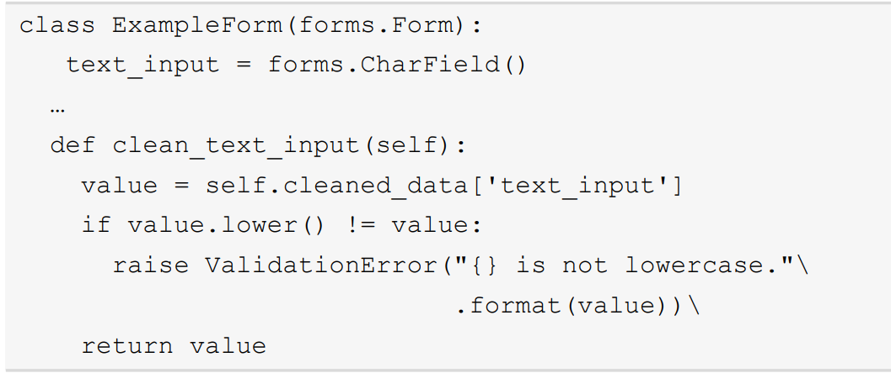
Cleaning Methods
Re-implement the lowercase validator as a clean.

Slide 10
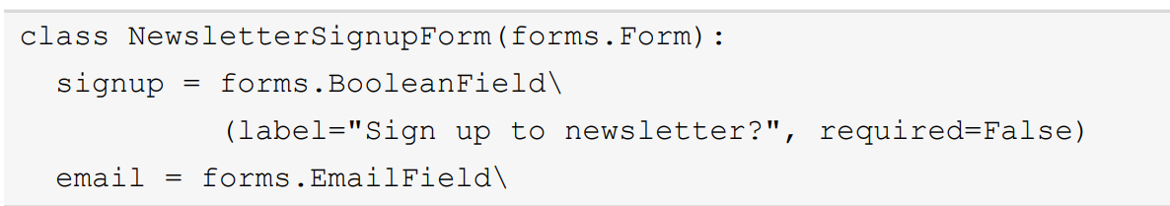
Multi-Field Validation
We have just looked at the clean_ methods that can be added to a Django form, to clean a specific field.

Slide 11
Multi-Field Validation
Label
This allows setting the label text for a field. As we have seen, Django will automatically generate label text from the field name. If you set the label argument, you can override this default. Use this argument if you want to have a more descriptive label.

Slide 12
Multi-Field Validation
help_text
If you need to have more information displayed regarding what input a field requires, you can use this argument. By default, it is displayed after the field.

Slide 13
Placeholders and Initial Values
While we are examining the Form class itself, we will look at the first of two ways of setting an initial value for a field. We can do it by using the initial argument on a Field constructor, like this.

Slide 14
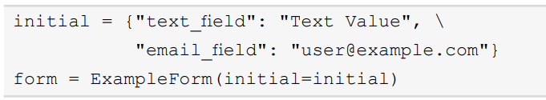
Placeholders and Initial Values
The dictionary should have zero or more items (that is, an empty dictionary is valid). Any extra keys are ignored. This dictionary should be supplied as the initial argument in our view as follows:

Slide 15
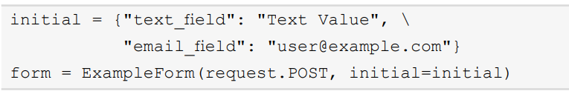
Placeholders and Initial Values
POST request, pass in request.POST as the first argument, as usual:

Slide 16
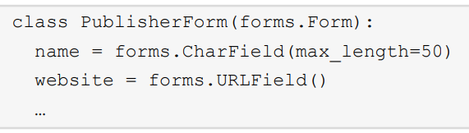
Creating or Editing Django Models
We can create a form based on an existing model, for example, Publisher. The form would be called PublisherForm.
We can manually define the fields on PublisherForm, using the same rules defined on the Publisher model.

Slide 17
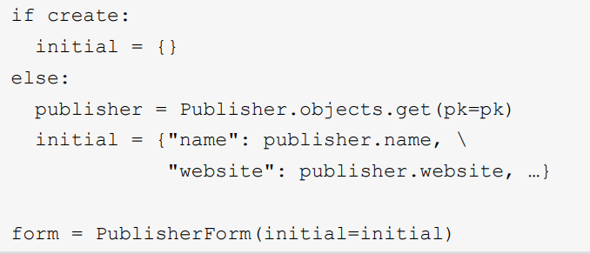
Creating or Editing Django Models
In the view, the initial values would be retrieved from the model queried from the database, then passed to the form using the initial argument.

Slide 18
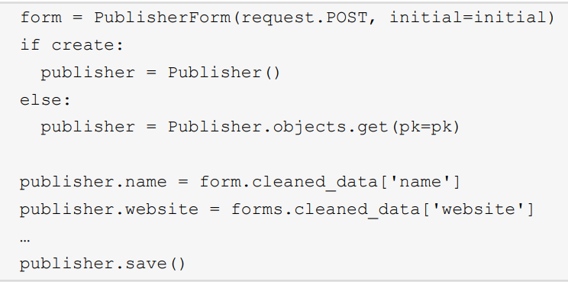
Creating or Editing Django Models
Then, in the POST flow of the view, we can either create or update the model based on cleaned_data.

Slide 19

The Model Form Class
Django provides a method of building Model instances from forms much more simply, with the ModelForm class. ModelForm is a form that is built automatically from a particular model.

Slide 20
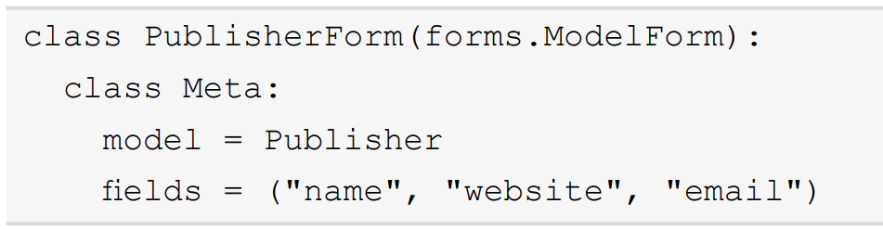
The Model Form Class
The class requires a class Meta attribute, which in turn must define a model attribute and either fields or excludes attributes.

Slide 21
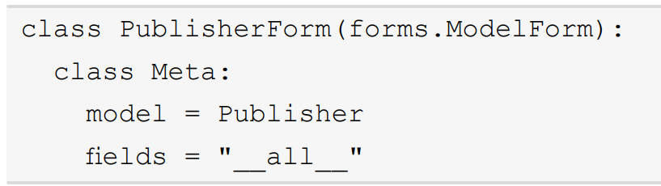
The Model Form Class
You can also use the special value __all__ instead of a list or tuple to automatically include all the fields, like this:

Slide 22
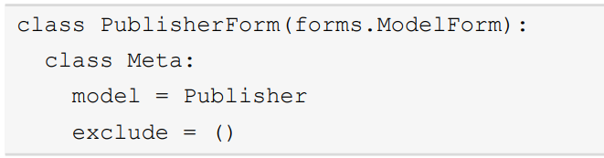
The Model Form Class
We could define the preceding form using exclude with any empty tuple since we want all the fields. The code is like this.

Slide 23
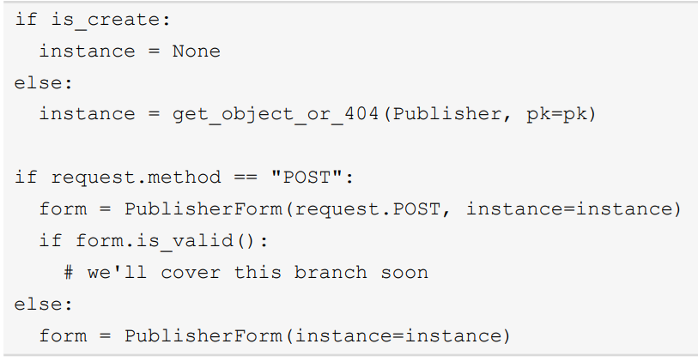
The Model Form Class
Your view function to create the form could then be written like this:

Slide 24
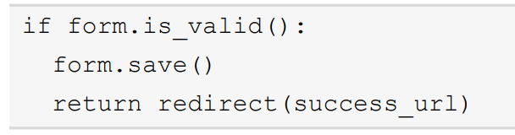
The Model Form Class
If the form is valid, we can then save the model instance.

Slide 25
Exercise
Exercise 7.01 to Exercise 7.03

Slide 26
Summary
This chapter was a deep dive into forms. We saw how to enhance Django forms with custom validation advanced rules for cleaning data and validating fields.
We saw how custom cleaning methods can transform the data that we get out of forms.
We then looked at how to use the ModelForm class to automatically create a form from a Django model.

Slide 27
Summary
We also saw how Django can automatically save the new or updated model instance to the database inside the view.
In the activities for this chapter, we enhanced Bookr some more by adding forms for creating and editing publishers and submitting reviews.

